Slide 1

Predictive Maintenance for Machines
Using machine learning

Slide 2
Topics
Introduction
Dataset Overview
Data Preparation
Exploratory Data Analysis (EDA)
Modeling with Single Random Split
Modeling with K-Fold Cross-Validation
Model Comparison
Conclusion

Slide 3
Introduction
Project Objective: Analyze sensor data from machines to predict potential failures.
Goal: Leverage various machine learning models to forecast machine failures based on sensor readings.
Models Employed: Logistic Regression, Random Forest, Gradient Boosting Machines (GBM)
Performance Metrics: Accuracy, Precision, Recall, F1-Score,ROC-AUC
Outcome: Identify the most effective model for predictive maintenance.
.

Slide 4
Dataset Overview
Source: UCI Machine Learning Repository: https://archive.ics.uci.edu/static/public/601/ai4i+2020+predictive+maintenance+dataset.zip
Dataset Composition:
Total Data Points: 10,000, Features: 14
Key Features:
UID: Unique identifier (1 to 10,000), Product ID: Quality variants (L, M, H) with serial numbers, Air Temperature [K]: Normalized around 300 K, Process Temperature [K]: Air temperature + 10 K, normalized, Rotational Speed [rpm]: Derived from power with noise, Torque [Nm]: Normally distributed around 40 Nm, Tool Wear [min]: Additional wear based on product quality, Machine Failure: Indicates failure occurrence
Failure Modes:
Tool Wear Failure (TWF): Random tool wear time (200-240 mins), Heat Dissipation Failure (HDF): Air and process temperature difference < 8.6 K, rotational speed < 1380 rpm, Power Failure (PWF): Power < 3500 W or > 9000 W, Overstrain Failure (OSF): Tool wear and torque product exceeds threshold, Random Failures (RNF): 0.1% chance of failure

Slide 5
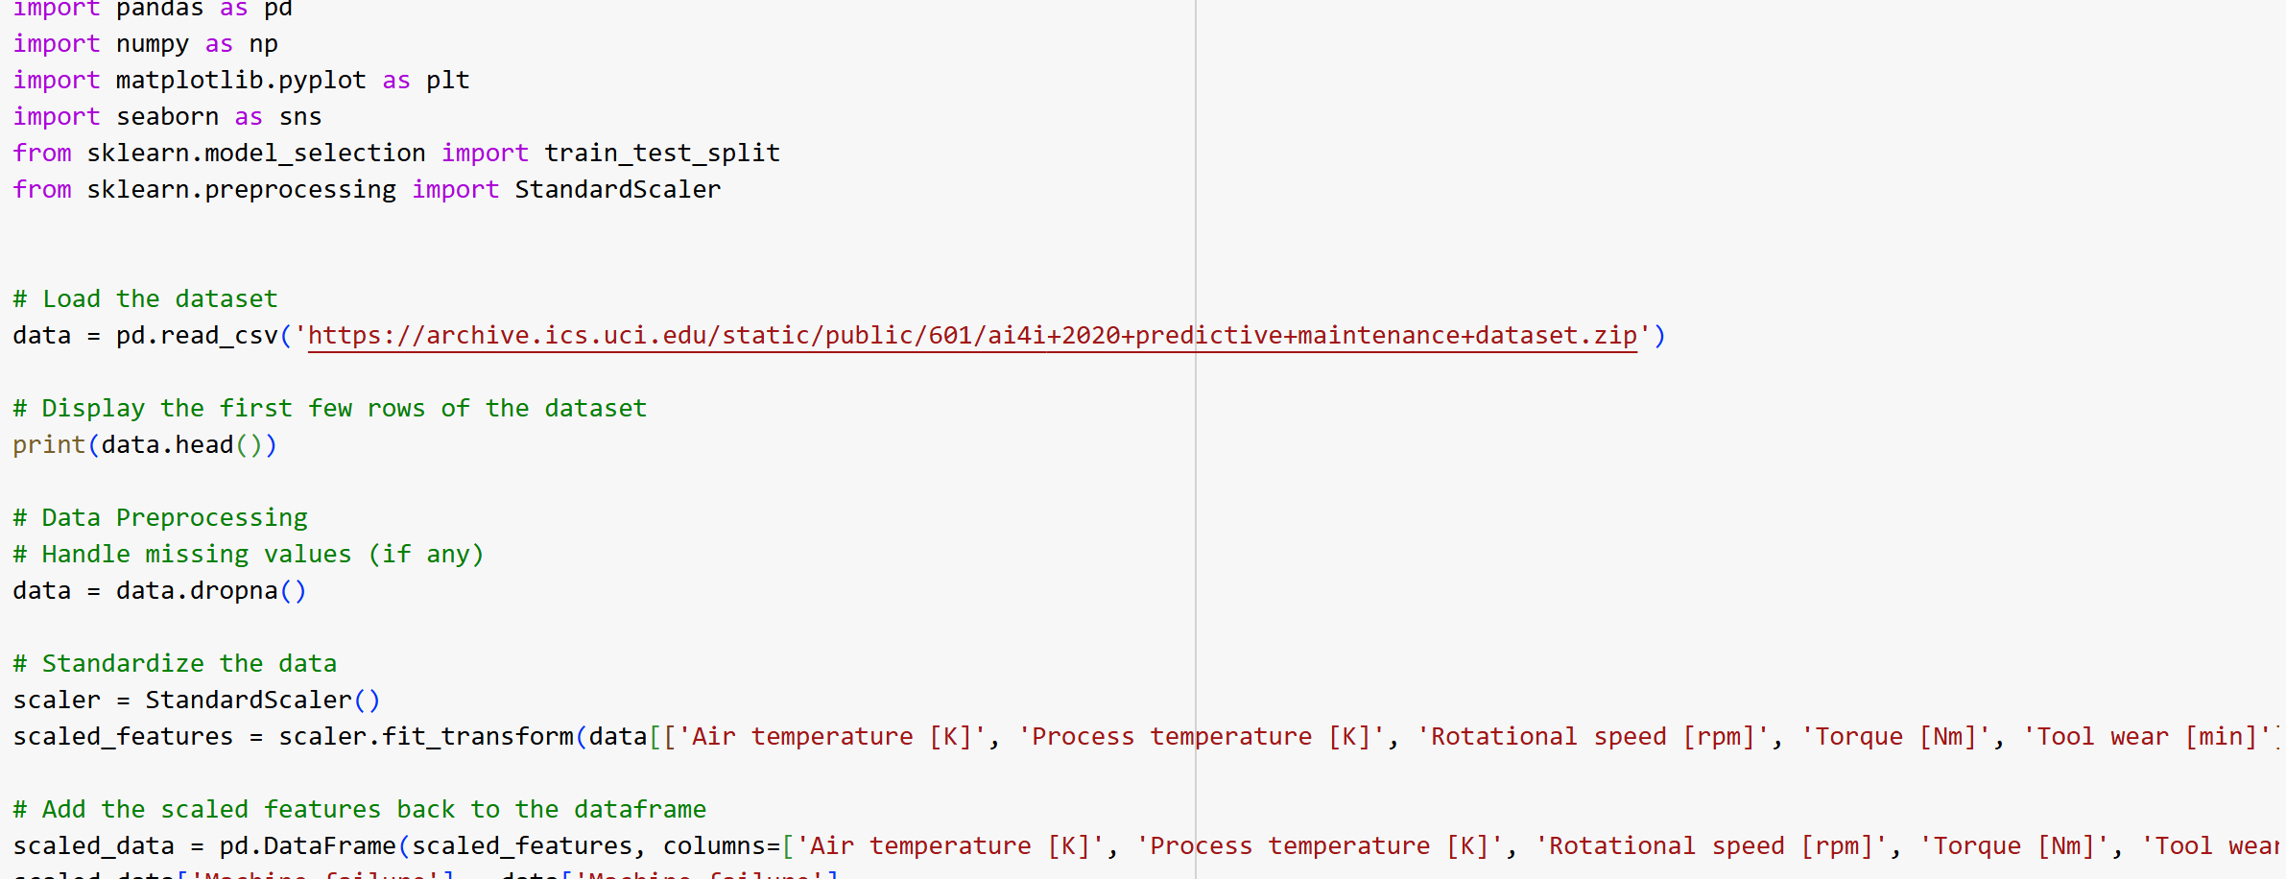
Data preparation
Steps for Data Preparation:
Load the Dataset:
Check for Missing Values:
Identify any missing values and handle them appropriately to ensure data integrity.
Standardize the Data:
Standardize the features to ensure all contribute equally to the model's performance

Slide 6
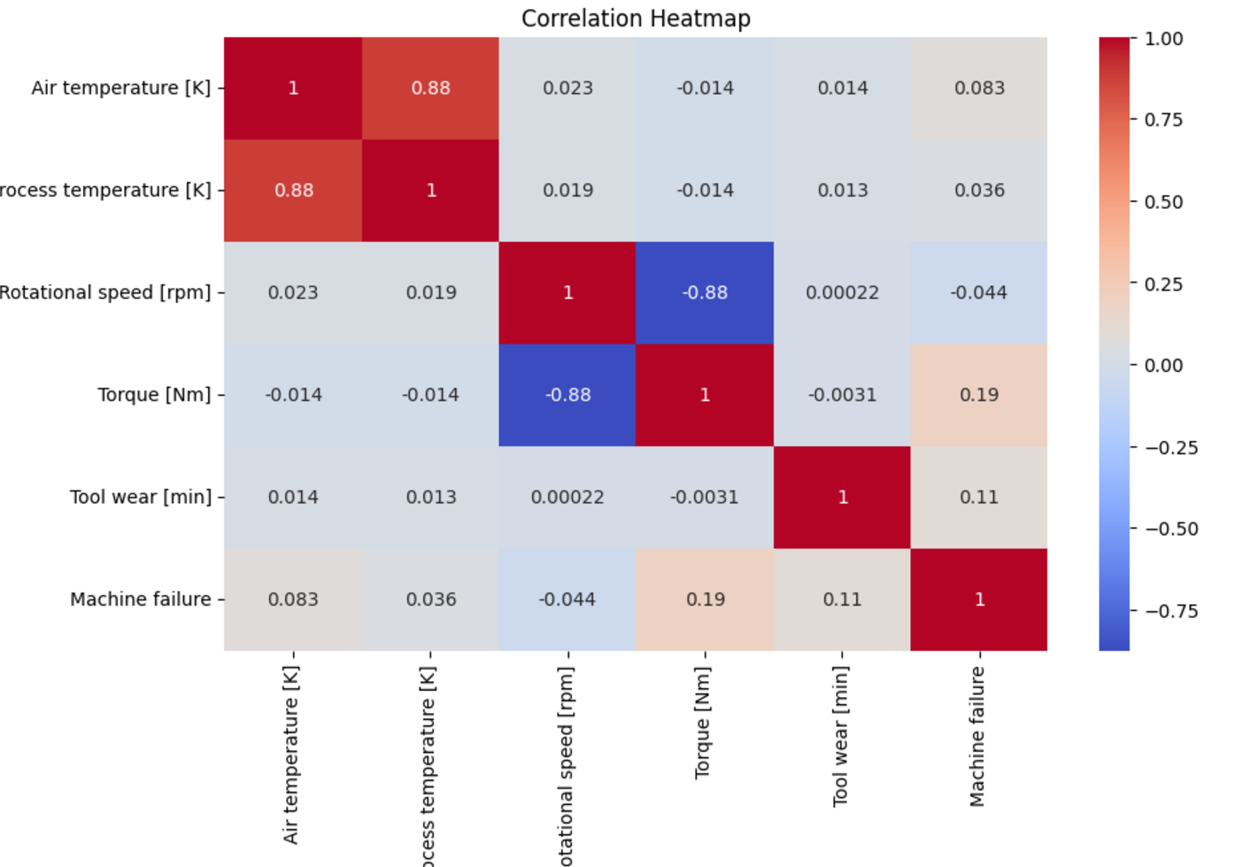
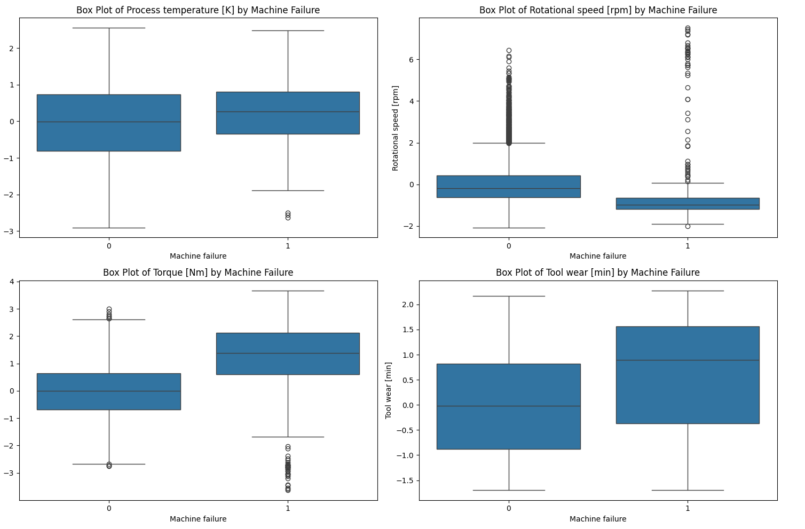
Exploratory Data Analysis (EDA)

Slide 7
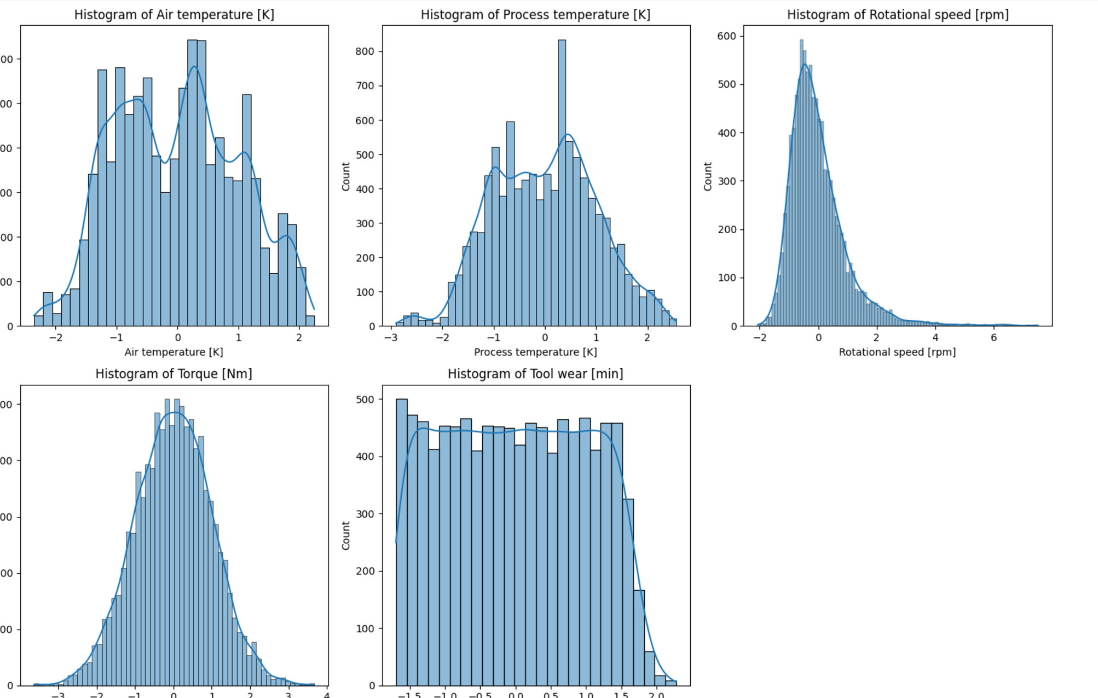
EDA

Slide 8
Modeling with Single Random Split
We have done 80:20 splits, so it has 8,000 in the training set and 2,000 in the test set.
Random Forest:
Accuracy: 98%
Precision (Class 1): 0.82
Recall (Class 1): 0.59
F1-Score (Class 1): 0.69
ROC AUC Score: 0.79
Logistic Regression:
Accuracy: 97%
Precision (Class 1): 0.64
Recall (Class 1): 0.26
F1-Score (Class 1): 0.37
ROC AUC Score: 0.63
Gradient Boosting:
Accuracy: 98%
Precision (Class 1): 0.74
Recall (Class 1): 0.66
F1-Score (Class 1): 0.70
ROC AUC Score: 0.82

Slide 9
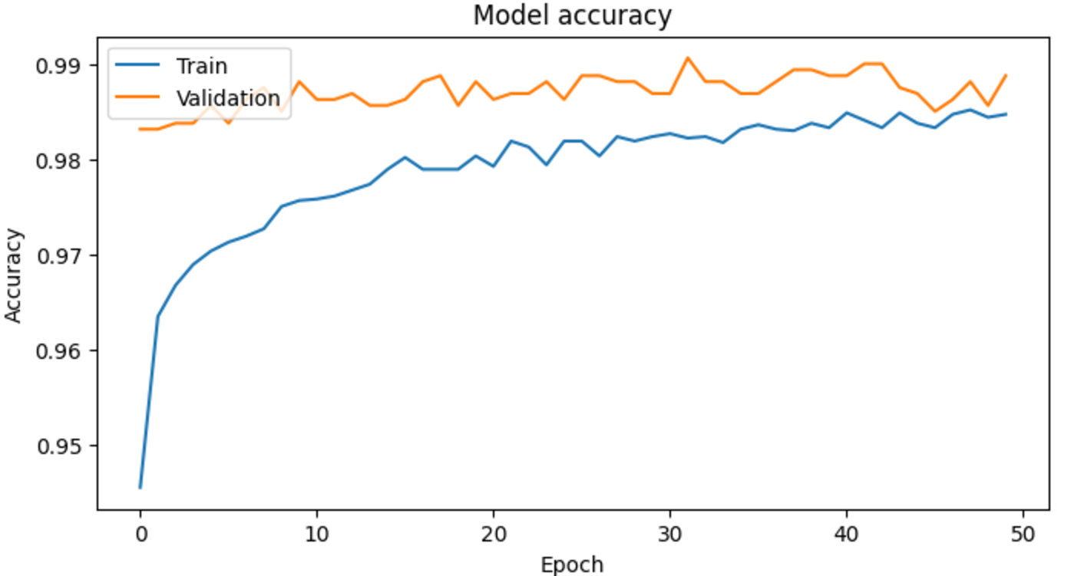
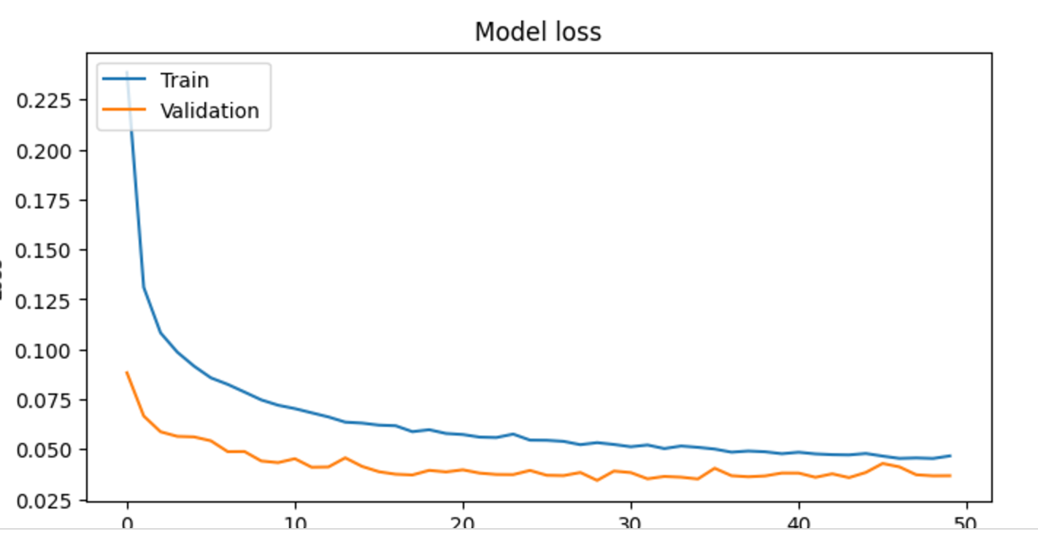
GRADIENT BOOSTING MODELING random split

Slide 10
Modeling with K-Fold Cross-Validation
Random Forest:
Accuracy: 0.98
Precision (Class 1): 0.88
Recall (Class 1): 0.63
F1-Score (Class 1): 0.73
ROC AUC Score: 0.81
Logistic Regression:
Accuracy: 0.97
Precision (Class 1): 0.73
Recall (Class 1): 0.20
F1-Score (Class 1): 0.30
ROC AUC Score: 0.60
Gradient Boosting:
Accuracy: 0.98
Precision (Class 1): 0.84
Recall (Class 1): 0.67
F1-Score (Class 1): 0.74
ROC AUC Score: 0.83

Slide 11
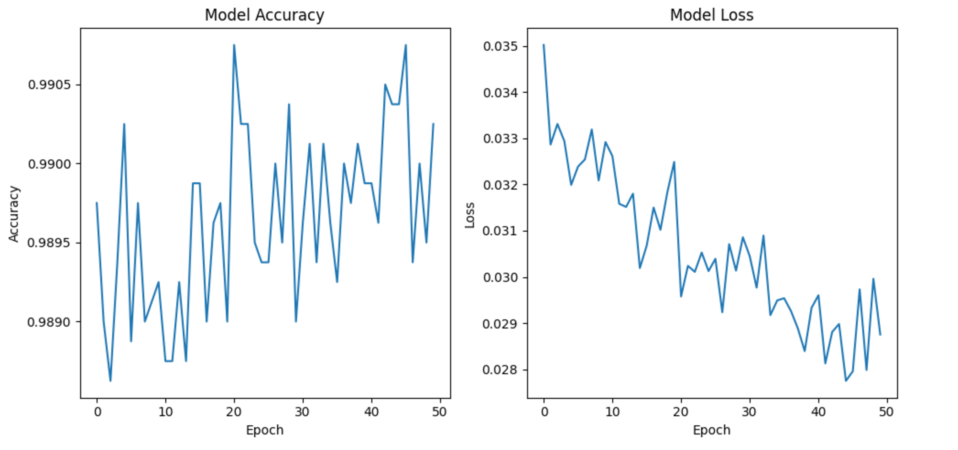
GRADIENT BOOSTING MODELING with k- fold cross validation

Slide 12
Difference Between SINGLE RANDOM SPLIT AND K-Fold Cross Validation
Particulars | Single Random Split | K-Fold Cross Validation
Performance Metrics | Optimistic | Robust and more reliable
Testing data | This model basically, split data into 80:20 and it does not represent the overall data distribution | This model is tested on multiple subsets of the data and is associated with single train-test split.

Slide 13
Recommendations
Logistic Regression: While it performs well overall, it may not be the best for identifying machine failures due to its lower recall in the 80-20 split.
Random Forest: With the good ROC AUC score in k-fold cross-validation, it is the best at distinguishing between machine failures and non-failures. Its robustness makes it a strong candidate for production.
Gradient Boosting: Offers a good balance between precision and recall, making it effective for handling complex patterns. It is a strong contender, especially if a balance between precision and recall is desired.

Slide 14

CONCLUSION
Comparing the two approaches, we see that K-Fold Cross-Validation provides a more reliable performance metric. Gradient Boosting emerged as the best model with a strong balance between precision and recall and good accuracy.

Slide 15
THANK YOU
Kirti Kankaria
Kirtikankaria@oakland.edu

